Slide 1
Lecture 1
SVD and PCA

Slide 2
SVD
A form of matrix decomposition (factorization into a product of matrices)
Other forms of matrix decomposition (Eigendecomposition, LU factorization/reduction--should be familiar from Math 54)
In singular value decomposition, the matrix can be written as a sum of rank-1 matrices
A = σ1u1vT1 + σ2u2vT2 + . . . + σnunvT (format later)
Each one of these matrices is a mode.
σ values: the singular values are square roots of eigenvalues from AA^{T} or A^{T}A.

Slide 3
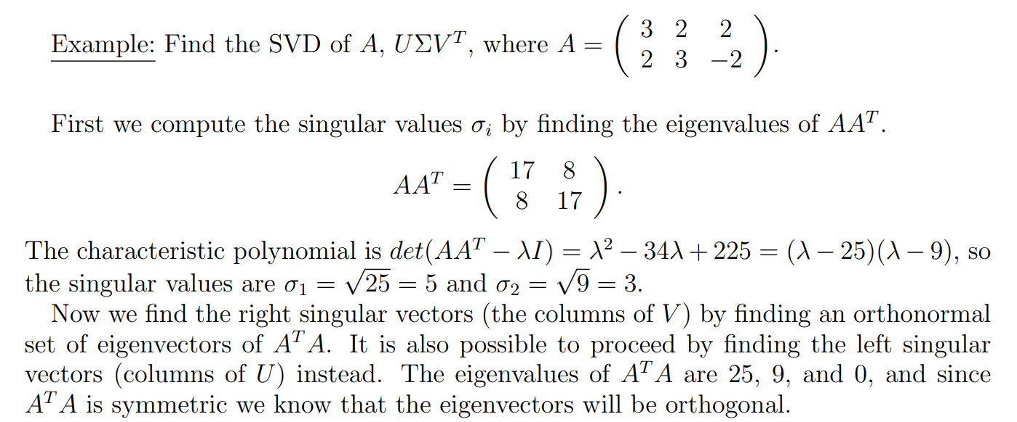
Numerical Example

Slide 4
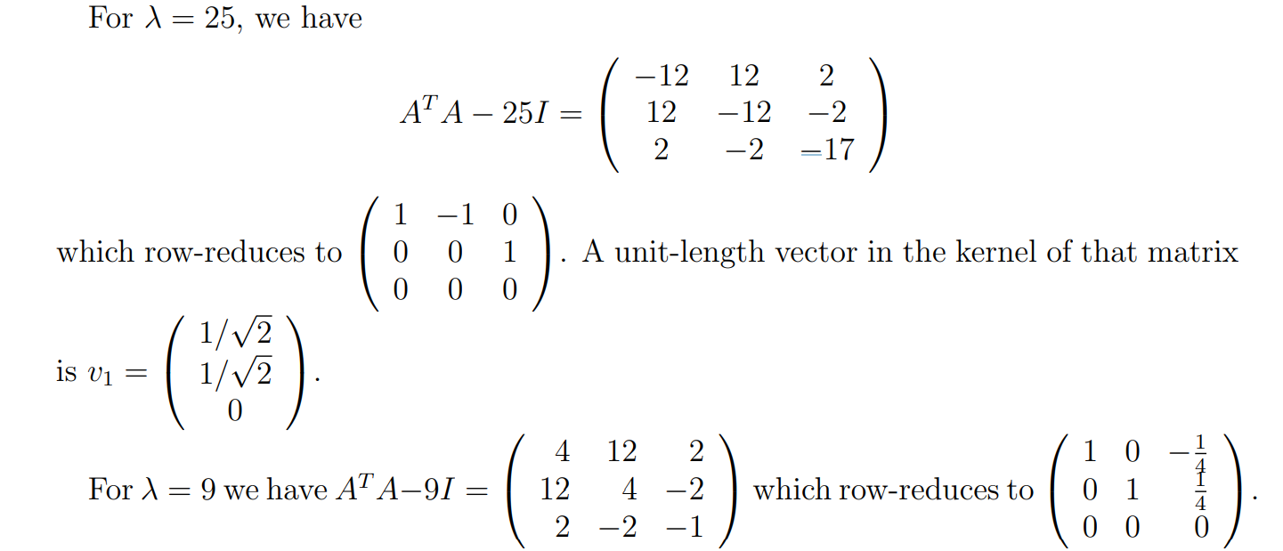

Slide 5
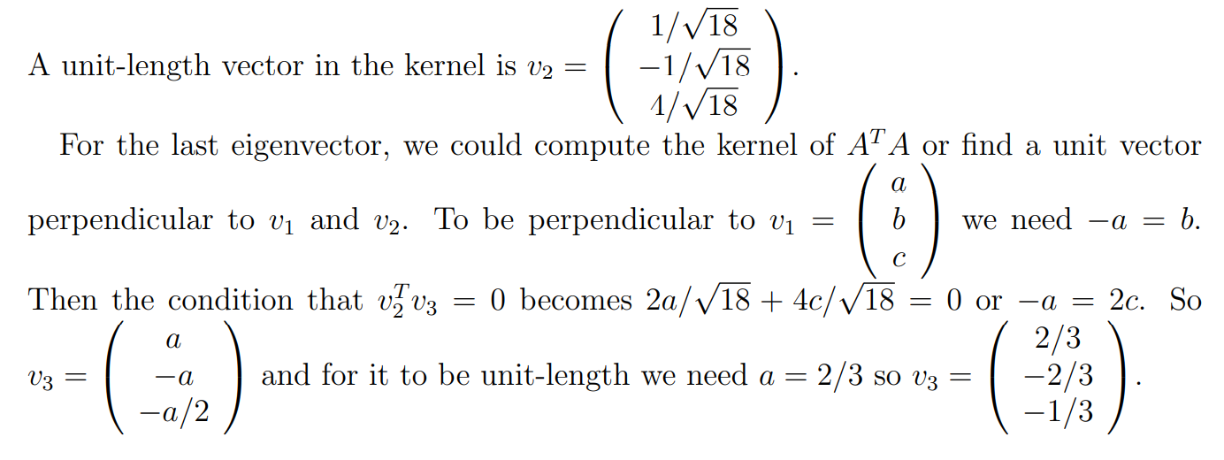

Slide 6
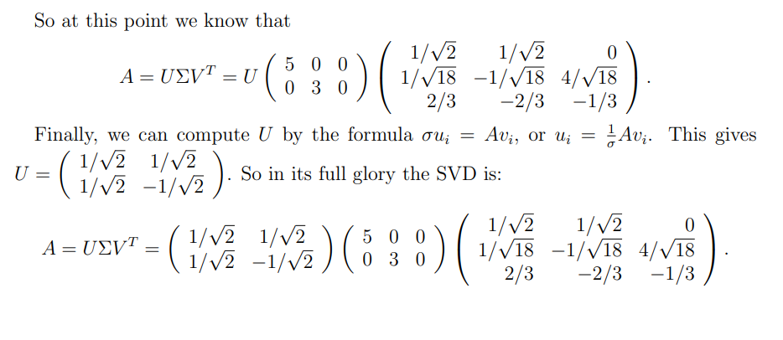

Slide 7
Application Example
Example (Netflix):¹ Suppose we have a m × n matrix that contains the ratings of m viewers for n movies. A truncated SVD as suggested above not only saves memory; it also gives insight into the preferences of each viewer. For example we can interpret each rank-1 matrix σi~ui~vT i to be due to a particular attribute, e.g., comedy, action, sci-fi, or romance content. Then σi determines how strongly the ratings depend on the i th attribute, the entries of ~vT i score each movie with respect to this attribute, and the entries of ~ui evaluate how much each viewer cares about this particular attribute. Then truncating the SVD as in (8) amounts to identifying a few key attributes that underlie the ratings. This is useful, for example, in making movie recommendations.
¹The material from this section was adapted from the EE16B 2017 course reader, Copyright © 2017 Murat Arcak and licensed under a Creative Commons Attribution-NonCommercialShareAlike 4.0 International License.

Slide 8
Applications
Some applications of the SVD:
Computing the pseudoinverse of a matrix
matrix approximation
determining the rank, range and null space of a matrix.
separable models.
nearest orthogonal matrix.
Kabsch algorithm (calculating the optimal rotation matrix that minimizes the root mean squared deviation between two paired sets of points)

Slide 9
PCA
dimensionality-reduction method: for analysis, it is often necessary to reduce the dimensionality of large data sets
transforming a large set of variables into a smaller one that still contains most of the information in the large set.
small loss of accuracy, but the aim is to achieve a simpler dataset by preserving as much information as possible.
Steps: standardization, covariance matrix computation, and identify principal components by computing the eigenvalues of the covariance matrix.
For standardization: subtract the mean and divide by the standard deviation for each value of each variable.

Slide 10


Standardization and computing the covariance matrix

Slide 11
Applications
Some applications of PCA:
Computing the pseudoinverse of a matrix
dimensionality reduction
multivariate analysis. E
data compression
image processing
Visualization
exploratory data analysis,
pattern recognition and time series prediction.

Slide 12
Application Example
As a technique, PCA is widely applicable in several fields.
For example, principal components are highly valuable in the prediction of stock prices and financial risk analysis, using variables like earnings yield and book to market ratio.
PCA is especially useful in image analysis.
Often, images of the same object will be taken multiple times under different lighting (i.e, green light, infrared, ultraviolet) which may lead to different features about the object being clearly captured in each image. PCA relies on the redundancy between these images as a reference to help obtain a final clear image. The first few principal components will yield the most accurate pictures, and subsequent principal components yield pictures that are progressively less defined.

